Slide 1
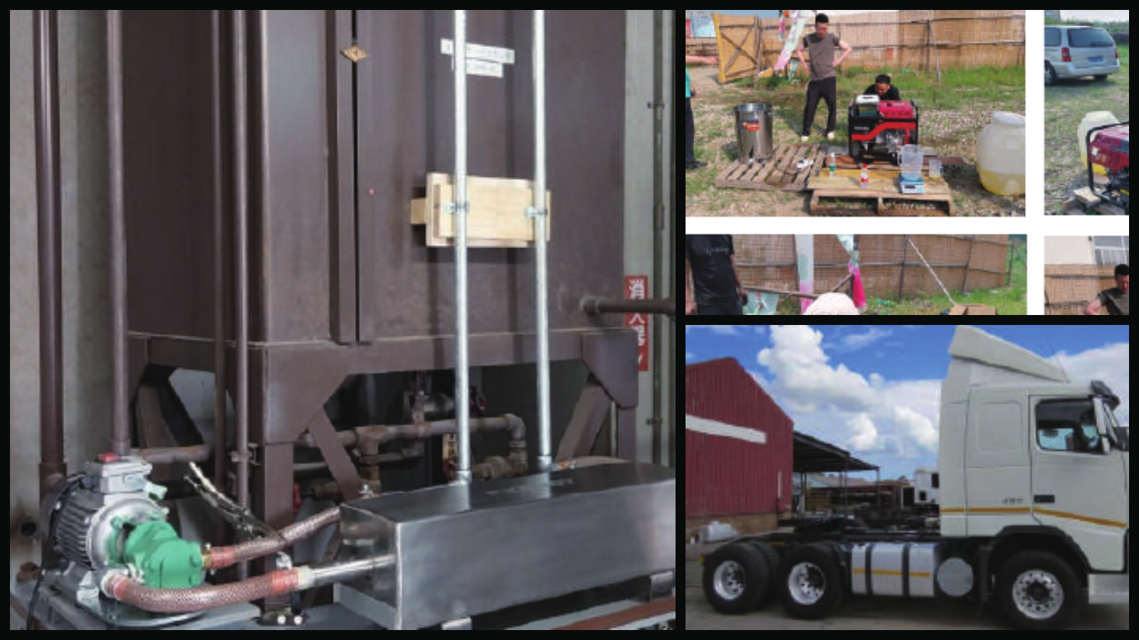
GLOBAL SALES DECK / 日英版
NEO-EXERGY
VERIFY BEFORE SCALE.
Fuel efficiency evaluated on your equipment—not a universal promise.
燃料費削減を、期待ではなく実機データで判断する。
BOILERS · GENERATORS · MARINE · TECHNICAL PARTNERS
NANOBEST JAPAN Co., Ltd.
Notes:
Open with the decision discipline: verify on the real asset before asking the buyer to scale.
[Sources]
- https://nanobestjapan.lsv.jp/
- OpenAI ImageGen concept visual created for this deck, 2026-08-21
[/Sources]

Slide 2
NEO-EXERGY / NANOBEST JAPAN
02
THE BUSINESS CASE
One fuel line. Two management outcomes.
一つの燃料費から、二つの経営改善を考える。
01
02
LOWER COST PER OUTPUT
ESTIMATE FUEL-DERIVED CO₂
生産量当たり燃料費
燃料由来CO₂を推定
Measure fuel against steam, power, heat or distance—not against expectation.
Use the verified fuel difference to calculate total fuel-derived CO₂ impact.
蒸気量・発電量・熱量・走行距離で補正して評価。
実測した燃料差から、燃料由来CO₂総量を算定。
DECISION RULE / 判断基準
No site-specific baseline, no savings claim.
Notes:
Position the offer as a measured improvement project, not a fixed-percentage device sale.
[Sources]
- https://nanobestjapan.lsv.jp/
- https://ghgprotocol.org/project-protocol
[/Sources]

Slide 3
NEO-EXERGY / NANOBEST JAPAN
03
WHERE TO START
Prioritize high-use assets with measurable output.
燃料使用量が大きく、生産量を測れる設備から始める。
01
⌁
02
⌁
03
⌁
04
⌁
INDUSTRIAL BOILERS
DIESEL GENERATION
MARINE & FISHING
HEAVY FLEETS
産業用ボイラー
ディーゼル発電
船舶・漁船
トラック・建設重機
Factories · hotels · food · textile · paper · laundry
Remote sites · mines · islands · construction · hotels
Auxiliary engines · generators · controlled voyage windows
Matched vehicles · controlled duty cycles · warranty review
L/t-steam
g/kWh
L/kWh
L/100km
Notes:
Lead with stable-load industrial assets. Fleet projects come later because operating variance and warranties complicate proof.
[Sources]
- https://nanobestjapan.lsv.jp/pdf/%E3%83%8D%E3%82%AA%E3%82%A8%E3%82%AF%E3%82%BB%E3%83%AB%E3%82%B8%E3%83%BC%E3%83%81%E3%83%A9%E3%82%B72025_compressed.pdf
- https://nanobestjapan.lsv.jp/pdf/%E3%80%90%E6%97%A5%E6%9C%AC%E8%AA%9E%E3%80%91%E3%80%801-%E4%BC%9A%E7%A4%BE%E3%83%97%E3%83%AC%E3%82%BC%E3%83%B3%E8%B3%87%E6%96%99_compressed.pdf
[/Sources]

Slide 4
NEO-EXERGY / NANOBEST JAPAN
04
RETROFIT CONCEPT
Condition in a loop. Verify at the asset.
燃料を循環処理し、既存設備で効果を確認する。
1
2
3
4
5
FUEL TANK
→
CIRCULATION PUMP
→
NEO-EXERGY
→
EXISTING ASSET
→
METERED OUTPUT
燃料タンク
循環ポンプ
燃油循環処理
既存燃焼設備
生産量・出力測定
SOURCE DESCRIPTION
Official material describes circulation treatment intended to reduce larger fuel agglomerates and support combustion. It does not establish a chemical molecular change.
公式資料の説明に基づき「循環処理による燃焼改善」と表現し、化学的な分子変化とは断定しません。
Notes:
Keep the mechanism statement narrow. Final model, flow, pressure, material, piping and local approval remain project-specific.
[Sources]
- https://nanobestjapan.lsv.jp/pdf/%E3%83%8D%E3%82%AA%E3%82%A8%E3%82%AF%E3%82%BB%E3%83%AB%E3%82%B8%E3%83%BC%E3%83%81%E3%83%A9%E3%82%B72025_compressed.pdf
[/Sources]

Slide 5
NEO-EXERGY / NANOBEST JAPAN
05
PUBLISHED SOURCE CASES
Three proof points. None is a universal guarantee.
三つの資料事例。どれも一律の保証値ではない。
DAYS 1–6
TWO TESTS
OFFICIAL SITE CASE
11–13%
6.1–11.2%
≈20%
南アフリカ発電機
中国・船舶発電機
中国B重油
NEO-100 · Euro 3 diesel · reported fuel-mass reduction
Euro 5 · two-hour runs · 15 circulation passes
Manufacturer-reported fuel cost and estimated CO₂ reduction; conditions unpublished
READ CORRECTLY
Results vary by fuel, asset, load, test design and time since conditioning.
Notes:
State the context before the percentage. The objective is to earn permission for a site pilot, not to imply guaranteed performance.
[Sources]
- https://nanobestjapan.lsv.jp/
- https://nanobestjapan.lsv.jp/pdf/%E3%80%90%E6%97%A5%E6%9C%AC%E8%AA%9E%E3%80%91%E3%80%801-%E4%BC%9A%E7%A4%BE%E3%83%97%E3%83%AC%E3%82%BC%E3%83%B3%E8%B3%87%E6%96%99_compressed.pdf
- https://nanobestjapan.lsv.jp/pdf/%E3%83%8D%E3%82%AA%E3%82%A8%E3%82%AF%E3%82%BB%E3%83%AB%E3%82%B8%E3%83%BC%E3%83%81%E3%83%A9%E3%82%B72025_compressed.pdf
[/Sources]

Slide 6
NEO-EXERGY / NANOBEST JAPAN
06
SOURCE-CASE TREND
The day-8 result changes the operating question.
8日目の結果から、再処理周期の検証が必要と分かる。
FUEL CONSUMED / 燃料消費量（g）
Baseline
722.5
—
OPERATING VARIABLE
Day 1
630
13%
7 DAYS
Day 3
625
13%
The source note says the fuel required re-conditioning after seven days.
Day 5
635
12%
Day 6
640
11%
資料注記：7日経過後、再度の燃油処理が必要。
Day 8
705
2%
Source-table values. Later dates appear to be single runs; repeatability and load normalization must be confirmed.
Notes:
This slide intentionally highlights the weaker day-8 result. It converts a credibility risk into an operating-protocol question.
[Sources]
- https://nanobestjapan.lsv.jp/pdf/%E3%80%90%E6%97%A5%E6%9C%AC%E8%AA%9E%E3%80%91%E3%80%801-%E4%BC%9A%E7%A4%BE%E3%83%97%E3%83%AC%E3%82%BC%E3%83%B3%E8%B3%87%E6%96%99_compressed.pdf
- Source table: NEO-100 diesel-generator test, South Africa, 21–28 Oct 2024
[/Sources]

Slide 7
MEASUREMENT INTEGRITY
07
CO₂ concentration is not the same as total CO₂.
排ガス中CO₂濃度と、燃料由来CO₂総量は別の指標です。
EXHAUST SAMPLE
TOTAL OPERATING IMPACT
CO₂ concentration may rise
Calculate from normalized fuel use
Published generator tests include treated runs with higher CO₂ concentration—consistent with more carbon reaching CO₂ in the sampled exhaust.
Record fuel input, useful output, load, test period and auxiliary power. Convert the verified fuel difference into fuel-derived CO₂.
濃度上昇例があるため「排ガス中CO₂が必ず低下」とは表現しません。
燃料投入量 ÷ 有効出力を補正比較し、実測燃料差から総量を算定。
CREDIBILITY ADVANTAGE / 正しく分けて説明することが、世界営業の信頼になります。
Notes:
Do not let prospects equate exhaust concentration with total emissions. Use normalized fuel consumption for the commercial and carbon decision.
[Sources]
- https://nanobestjapan.lsv.jp/pdf/%E3%80%90%E6%97%A5%E6%9C%AC%E8%AA%9E%E3%80%91%E3%80%801-%E4%BC%9A%E7%A4%BE%E3%83%97%E3%83%AC%E3%82%BC%E3%83%B3%E8%B3%87%E6%96%99_compressed.pdf
- https://ghgprotocol.org/project-protocol
[/Sources]

Slide 8
NEO-EXERGY / NANOBEST JAPAN
08
FOUR-GATE PILOT
A buying process designed to survive technical review.
技術審査に耐える、4段階の実証プロセス。
01
02
03
04
QUALIFY
BASELINE
VERIFY
DECIDE
適合診断
基準測定
管理試験
ROI・拡大判断
Fuel · volume · asset · load · tank · piping · local rules
Choose L/t-steam, g/kWh, fixed-load L/h or L/100 km
Comparable runs · raw data · repeatability · exceptions
Measured reduction · installation · operation · maintenance
GO / NO-GO AFTER EVIDENCE · 証拠が揃ってから投資判断
Notes:
Use the four gates to qualify serious buyers and protect both the manufacturer and local partner from overclaiming.
[Sources]
- https://ghgprotocol.org/project-protocol
- NEO-EXERGY evidence-led pilot design prepared from official NANOBEST source cases, 2026-08-21
[/Sources]

Slide 9
NEO-EXERGY / NANOBEST JAPAN
09
COMMERCIAL THRESHOLD
Model the pilot before spending capital.
設備投資の前に、成立条件を試算する。
Illustrative inputs: 50,000 L/month × 1.10 currency/L
SCENARIO
MONTHLY SAVING
ANNUAL SAVING
USE
5%
2,750
33,000
CONSERVATIVE / 保守
8%
4,400
52,800
PLANNING / 基準
12%
6,600
79,200
UPSIDE / 上振れ
SCENARIO ONLY — not a savings or payback guarantee. Replace assumptions with site data.
Notes:
Invite the buyer to set their minimum acceptable result. The project advances only if measured data clears that threshold.
[Sources]
- Illustrative calculation prepared for this deck: monthly saving = monthly volume × unit price × scenario reduction
[/Sources]

Slide 10
NEO-EXERGY / NANOBEST JAPAN
10
WORLDWIDE PARTNER PROGRAM
Build a technical market—not a one-off introduction.
単発紹介ではなく、技術と市場を一緒に作る。
FROM NANOBEST JAPAN
FROM THE LOCAL PARTNER
メーカー支援
現地パートナー
✓
Product & evidence orientation
→
Relevant customer base
✓
Opportunity qualification support
→
Technical staff or engineering allies
✓
Pilot and measurement guidance
→
Ability to support a controlled pilot
✓
Localized sales-material development
→
Target-sector activity plan
✓
Territory discussion after execution
→
Responsible, evidence-led sales conduct
EXCLUSIVITY FOLLOWS EVIDENCE OF EXECUTION — not the first conversation.
Notes:
Recruit technical distributors with measurement and service capability. Do not promise exclusivity before pilot execution and market activity.
[Sources]
- NANOBEST overseas business strategy meeting notes supplied by the user, 2026-08-21
- https://nanobestjapan.lsv.jp/
[/Sources]

Slide 11
NEO-EXERGY / NANOBEST JAPAN
11
BEFORE A COUNTRY LAUNCH
Turn missing information into a qualification checklist.
不足情報を、案件審査と国別公開のチェックリストにする。
PRODUCT
EVIDENCE
MARKET
製品仕様
実証根拠
国別対応
Model naming
Raw measurements
Local safety and approvals
Flow / pressure / temperature
Load and output normalization
Equipment warranty impact
Materials and connections
Instrument calibration
Trademark / sales rights
Pump power and maintenance
CO₂ calculation boundary
Claims and translation review
NAMING RULE
Use NEO-EXERGY as the product family. Treat Neo Excel G as unconfirmed wording until written clarification.
Notes:
This checklist protects the country launch. Resolve each item before converting a pilot landing page into a hard-claim product page.
[Sources]
- https://nanobestjapan.lsv.jp/pdf/%E3%83%8D%E3%82%AA%E3%82%A8%E3%82%AF%E3%82%BB%E3%83%AB%E3%82%B8%E3%83%BC%E3%83%81%E3%83%A9%E3%82%B72025_compressed.pdf
- https://nanobestjapan.lsv.jp/pdf/%E3%80%90%E6%97%A5%E6%9C%AC%E8%AA%9E%E3%80%91%E3%80%801-%E4%BC%9A%E7%A4%BE%E3%83%97%E3%83%AC%E3%82%BC%E3%83%B3%E8%B3%87%E6%96%99_compressed.pdf
- https://nanobestjapan.lsv.jp/pdf/EN%20pdf/1-%E4%BC%9A%E7%A4%BE%E3%83%97%E3%83%AC%E3%82%BC%E3%83%B3%E8%B3%87%E6%96%99%E3%80%80%E8%8B%B1%E8%AA%9E_compressed.pdf
[/Sources]

Slide 12
NEXT STEP / 次のステップ
Tell us about the asset, not just the country.
国名だけでなく、対象設備を教えてください。
1
2
3
4
5
Fuel type / 燃料種
Monthly use / 月間使用量
Asset & output / 設備・生産量
Operating hours / 稼働時間
Target market / 対象国・業界
REQUEST A SITE-FIT & ROI ASSESSMENT / 適合性・概算ROI診断
START →
nanobestjapan.worlddesk@outlook.com
NANOBEST JAPAN Co., Ltd. · INTERNATIONAL BUSINESS DEVELOPMENT
Notes:
End with the five facts needed to qualify an operator or distributor conversation.
[Sources]
- https://nanobestjapan.lsv.jp/
- International inquiry desk supplied by the user: nanobestjapan.worlddesk@outlook.com
[/Sources]

